Slide 1
Precision-Based Investment Selection Framework
Predictive modelling for high-confidence restaurant investment decisions in European markets

Slide 2
Our Clients
Individual Investors
Banks, Insurance companies and Lenders
Risk‑Averse Investors
These are people who prefer:
- Fewer deals
- Higher confidence
- Lower downside risk

Slide 3
Base line
Great = TripAdvisor rating greater than 4.0

Slide 4
Strategic Mandate
Investment decisions are driven by cost asymmetry, where capital loss risk outweighs missed opportunity cost
The system is designed as a precision-first framework for conservative capital allocation
The model targets a strict 80% precision threshold for recommended investments

Slide 5
Decision Pipeline
Raw Data → Signal Extraction → Predictive Modeling → Risk Filtering → Investment Decision
A structured pipeline that transforms raw behavioral and geographic data into actionable investment signals. Each stage is optimized to progressively refine high-probability success candidates for final selection.

Slide 6
Data Integrity & Stability
Restaurants with fewer than 20 reviews were excluded to reduce statistical noise
This ensures rating signals reflect stable market consensus rather than short-term variance
The final dataset represents a reliable baseline for predictive modeling

Slide 7
Primary Business Signals
Cuisine Diversity: Indicator of market positioning and operational complexity
Brand Factor (Chain vs Independent): Associated with stability in rating distributions and operational consistency
Geographic Anchors for handling missing values(Country): Enable cross-market generalization and reduce local overfitting

Slide 8
Model Selection Table
Model | Accuracy | Precision | Recall | f1-score | AUC
Decision Tree (Baseline) | 0.673502 | 0.656334 | 0.366872 | 0.470659 | 0.620556
Random Forest | 0.69402 | 0.669782 | 0.447026 | 0.536189 | 0.651371
Gradient Boosting | 0.694485 | 0.656147 | 0.478636 | 0.553507 | 0.657214
XGBoost | 0.694282 | 0.655622 | 0.478786 | 0.553421 | 0.657072
AdaBoost | 0.659517 | 0.66047 | 0.286928 | 0.400059 | 0.595182
Multiple tree-based models were benchmarked to evaluate the trade-off between predictive power and precision stability

Slide 9
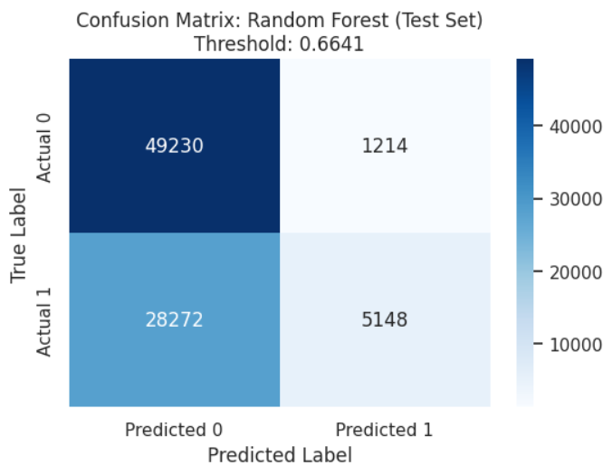
Performance Summary
Metric | Random Forest (Optimized) | Random Forest (Baseline)
Precision | 81% | 67%
Recall | 16% | 44%
Roc-Auc | 0.57 | 0.66
We trade coverage for confidence
The system is intentionally optimized for investment quality over market coverage
High precision ensures strong confidence in selected investment candidates

Slide 10
Risk & Limitations
Dataset exhibits survivorship bias due to reliance on currently listed restaurants
External macroeconomic variables are not included in the current model
Predictions reflect historical behavioural patterns and do not capture real-time market shocks

